Slide 1
DNS Anomaly Detection
AI Security Issues

Slide 2
Maryam Waheed Zamel ID : 2205154 Amina Ahmed Ferra ID : 2205225 Mayssoune Hussein ElMasry ID : 2205251 Hanin Mohamed Hamouda ID : 2205232
Team Members

Slide 3
Table Of Content
Why DNS Anomaly Detection
What is DNS Cache Poisoning
About The Data
Feature Selection
Alogrithms Applied
Conclusion

Slide 4
Why DNS Anomaly Detection
DNS (Domain Name System) is the backbone of the internet, where it translates domain names like example.com into IP address. However, thus critical System is prone to cyberattacks. It is vulnerable to cache poisoning attacks which result in:
Phishing
Malware Distribution
Service Disruption
So ,DNS Anomaly Detection is used to identify unusual DNS patterns, such as abnormal query volumes, low TTL values, or Suspicious transaction ID entropy, to prevent such attacks.

Slide 5
What is DNS Cache Poisoning
DNS Cache Poisoning, or DNS spoofing, is a cyberattack where fake DNS responses are injected into a resolver's cache, redirecting users to malicious IP addresses.
The attacker floods the resolver with fake responses while it waits for a legitimate one, attempting to guess the correct Transaction ID If successful, the resolver accepts and caches the fake IP as valid. As a result, future queries for the poisoned domain redirect users to the malicious server.

Slide 6
About The Data
The Data is synthetic, which mimics the behavior of real DNS queries by creating patterns that reflect normal traffic and anomalies. For example, normal data will have consistent query volumes, TTL values, and transaction ID entropy, while anomalies include irregular patterns like high query volumes, low TTL values, or predictable transactions ID.
Synthetic data ensures that Machine learning can detect anomalies effectively ,provides flexibility , and designs scenarios for DNS cache poisoning ,so it is useful and safe for training and testing.

Slide 7
About The Data
The dataset used for the DNS anomaly detector is unsupervised in nature because it lacks predefined labels indicating "normal" or "anomalous" DNS traffic.The dataset consists of 1000 rows & 6 columns.
The data’s Features:
Timestamp (DateTime): Records the exact time of each DNS query or response.
Source_IP (IPV4 or IPV6): Represents the IP address of the device initiating the DNS query.
Destination_IP (IPV4 or IPV6): Represents the IP address of the DNS server or resolver receiving the query.
Query_Volume (Integer): The number of DNS queries sent in a defined period.
TTL_Value (Integer): Specifies the duration a DNS record remains valid in the cache before expiration.
Transaction_ID_Entropy (Float): A measure of randomness in DNS transaction IDs, which link queries to their responses.

Slide 8
Feature Selection
As the data is Synthetic , It doesn’t need any preprocessing as it is designed to simulate realistic DNS traffic with predefined patterns that is ready for training and testing.
So, we just selected the features that are relevant for DNS anomaly detection.
The Selected Features:
Query_Volume: Monitoring query volume allows the model to detect unusual traffic patterns that might signify an attack or misconfiguration in the DNS server.
TTL_Value (Time-to-Live): Unusual TTL behavior (such as very low TTL values) may indicate an attempt to manipulate DNS caches, a common tactic in DNS cache poisoning.
Transaction_ID_Entropy: Low entropy in TXIDs can indicate that an attacker is trying to guess TXIDs to inject fake DNS records. Monitoring entropy helps in identifying this vulnerability.

Slide 9
Alogrithms Applied
The selection of ML Alogrithms like Isolation Forest, KMeans Clustering, and One-Class SVM for DNS anomaly detection is based on their ability for handling unsupervised learning tasks, where no labeled data is available. These models analyze the underlying patterns in DNS traffic and identify unusual patterns as anomalies, effectively adding labels to the data by distinguishing normal points from outliers.

Slide 10
Alogrithms Applied
Model | Isolation Forest | K-Means | One-Class SVM
How it works | isolates anomalies by recursively partitioning the data using random splits on features. Anomalies are isolated faster since they require fewer splits. | groups data into clusters based on feature similarity. Points far from cluster centers are flagged as anomalies | learns a boundary around the normal data using support vectors. Points outside this boundary are flagged as anomalies.
Advantages | Fast, scalable, and works for large, high-dimensional data. | Simple, scalable, and effective for clear clusters. | Effective for small datasets, clear boundaries.
Disadvantages | Sensitive to parameters, may overfit small datasets. | Requires predefined clusters, struggles with non-spherical data. | Slow for large datasets, sensitive to parameters.

Slide 11
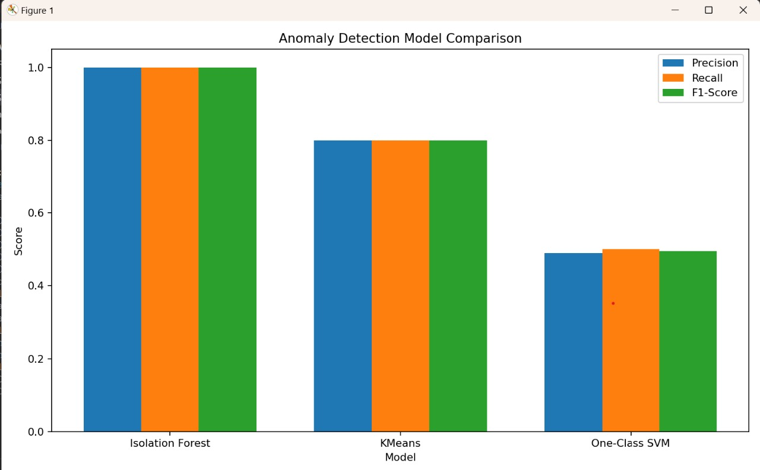
Conclusion

Slide 12
Conclusion
We tested three anomaly detection models: Isolation Forest, K-Means, and One-Class SVM.
Isolation Forest achieved the highest precision, recall, and F1-Score, making it look like the optimal solution. However, it suffers from overfitting, limiting its ability to handle unseen data.
K-Means performed consistently well across the metrics. It avoids overfitting and generalizes better, making it more reliable for real-world scenarios.
One-Class SVM showed the lowest performance, indicating it struggles with the complexity of the data and is less suitable.

Slide 13
Conclusion
After comparing all three models:
Isolation Forest delivers the best scores but is impacted by overfitting.
K-Means delivers the optimal solution, balancing performance and generalization.
One-Class SVM remains the weakest choice.
The final recommendation is K-Means because it offers consistent performance and avoids overfitting, ensuring robust DNS anomaly detection.

Slide 14
Thank you

